Slide 1
Digital Image Processing
Image Restoration: Noise Removal
Dr. Ahmed Yousry

Slide 2
Contents
In this lecture we will look at image restoration techniques used for noise removal
What is image restoration?
Noise and images
Noise models
Noise removal using spatial domain filtering
Periodic noise
Noise removal using frequency domain filtering

Slide 3
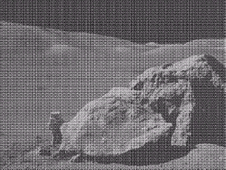
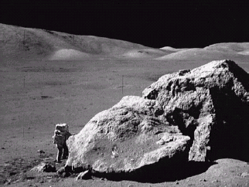
What is Image Restoration?
Image restoration attempts to restore images that have been degraded
Identify the degradation process and attempt to reverse it
Similar to image enhancement, but more objective

Slide 4
The purpose of image restoration is to "compensate for" or "undo" defects which degrade an image.
Degradation comes in many forms such as motion blur, noise, and camera misfocus.
In cases like motion blur, it is possible to come up with a very good estimate of the actual blurring function and "undo" the blur to restore the original image.
In cases where the image is corrupted by noise, the best we may hope to do is to compensate for the degradation it caused

Slide 5
Degradation of images can have many causes
defects of optical lenses;
nonlinearity of the electro-optical sensor;
graininess of the film material;
relative motion between an object and camera
wrong focus,
atmospheric turbulence in remote sensing or astronomy,
etc.
The objective of image restoration is to reconstruct the
original image from its degraded version.

Slide 6
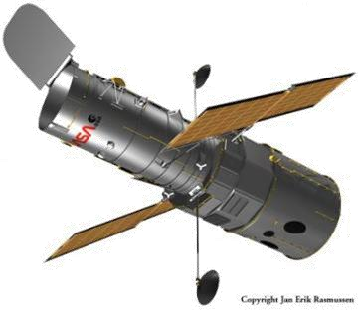
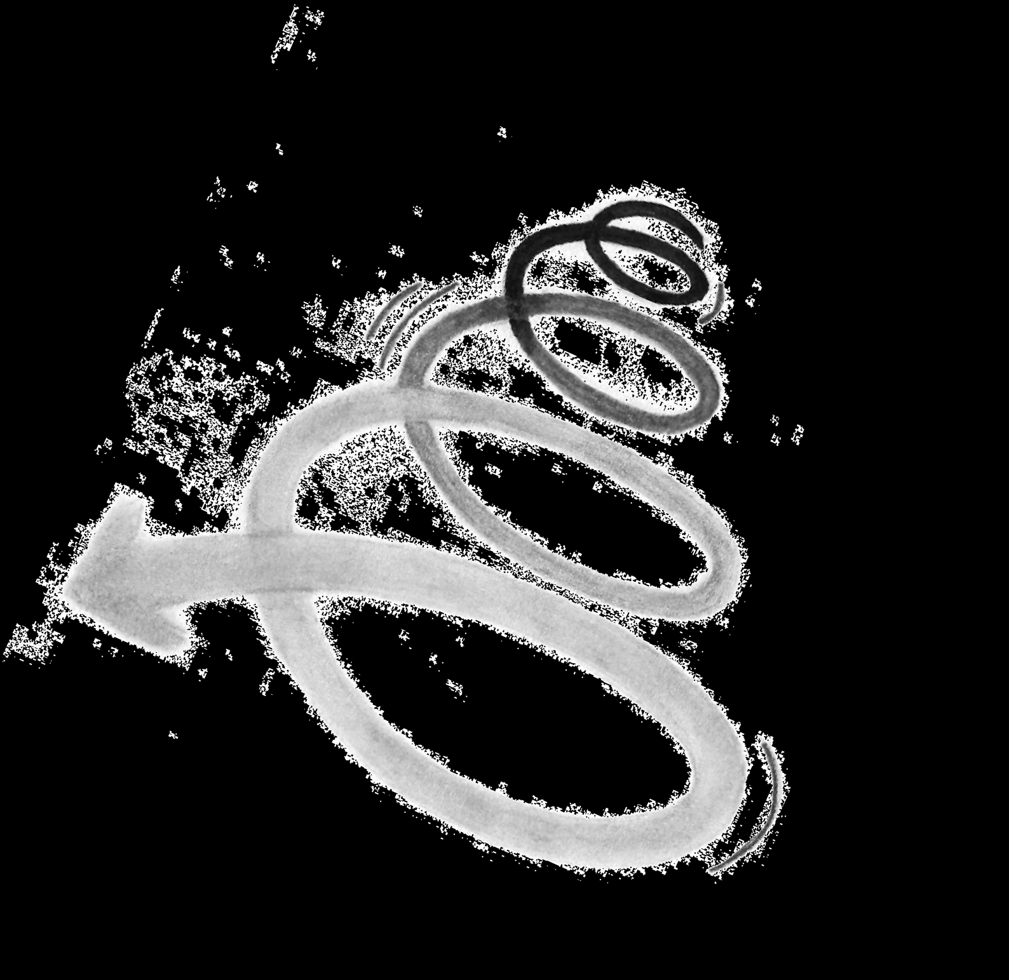

Noise and Images
The sources of noise in digital images arise during image acquisition (digitization) and transmission
Imaging sensors can be affected by ambient conditions
Interference can be added to an image during transmission
Notes:
يمكن أن تتأثر أجهزة الاستشعار التصويرية بالظروف المحيطة.
قد يتم إضافة تداخل إلى الصورة أثناء الإرسال.

Slide 7
Noise Model
We can consider a noisy image to be modelled as follows:
g(x, y) = f (x, y) + η(x, y)
where f(x, y) is the original image pixel, η(x, y) is the noise term and g(x, y) is the resulting noisy pixel
If we can estimate the model the noise in an image is based on, this will help us to figure out how to restore the image

Slide 8
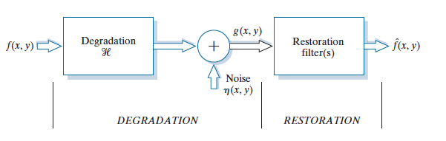
Image Restoration

Slide 9
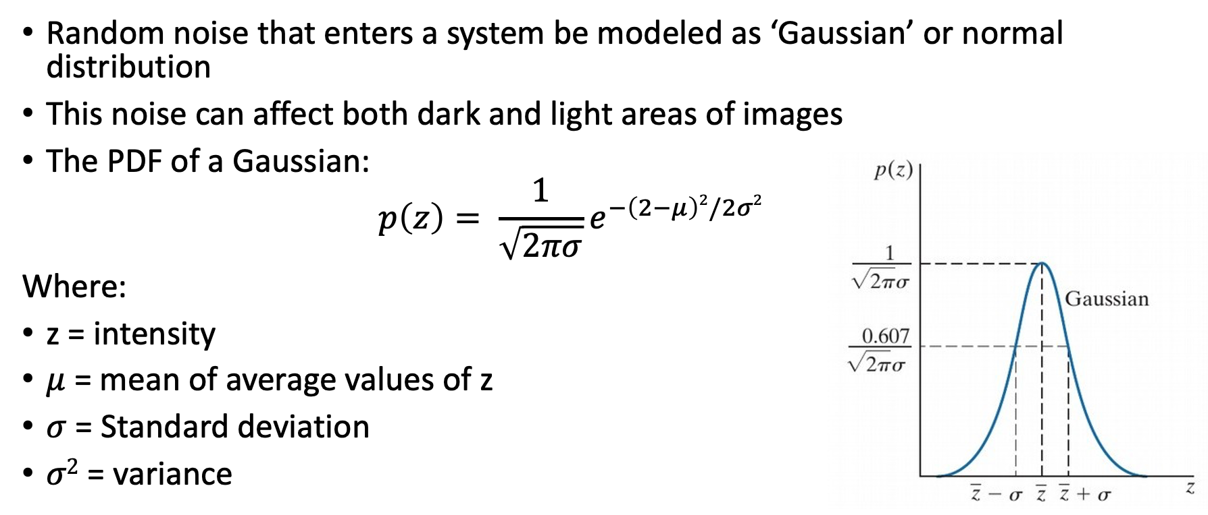
Gaussian Noise

Slide 10
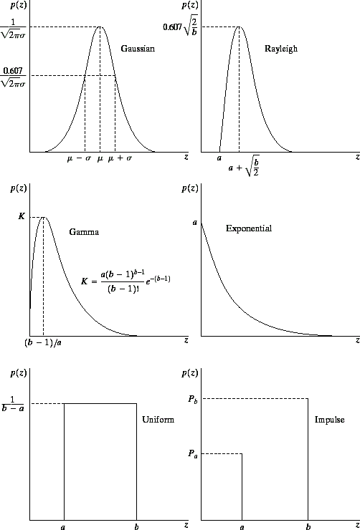
Noise Models
There are many different models for the image noise term η(x, y):
Gaussian
  Most common model
Rayleigh
Erlang
Exponential
Uniform
Impulse
  Salt and pepper noise
Images taken from Gonzalez & Woods, Digital Image Processing (2002)
Gaussian
Rayleigh
Erlang
Exponential
Uniform
Impulse

Slide 11

Noise Example
Images taken from Gonzalez & Woods, Digital Image Processing (2002)
The test pattern to the right is ideal for demonstrating the addition of noise
The following slides will show the result of adding noise based on various models to this image
Image
Histogram to go here
Histogram

Slide 12
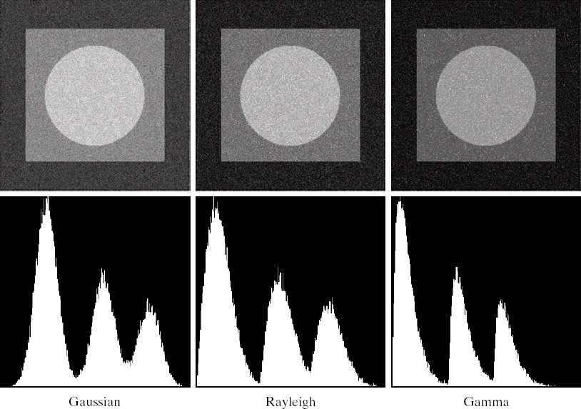
Noise Example (cont…)
Images taken from Gonzalez & Woods, Digital Image Processing (2002)
Gaussian
Rayleigh
Erlang

Slide 13
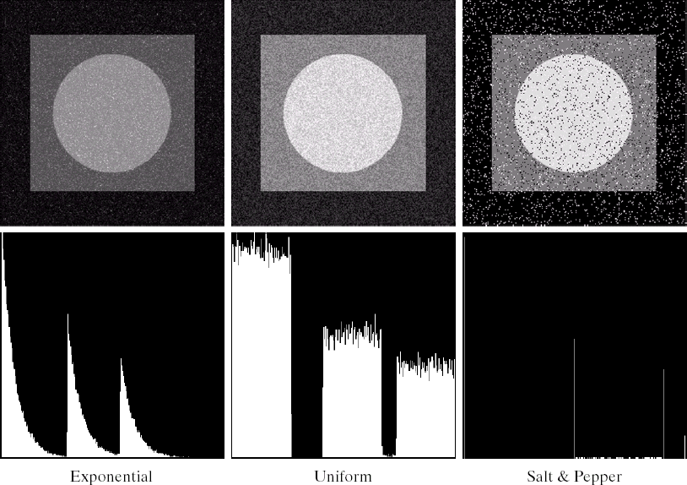
Noise Example (cont…)
Images taken from Gonzalez & Woods, Digital Image Processing (2002)
Histogram to go here
Exponential
Uniform
Impulse

Slide 14
Filtering to Remove Noise
We can use spatial filters of different kinds to remove different kinds of noise
The arithmetic mean filter is a very simple one and is calculated as follows:
f^{ˆ}(x, y) = ¹
∑ g(s, t)
^{mn} ( s,t )∈S
xy
1_{/9} | 1_{/9} | 1_{/9}
1_{/9} | 1_{/9} | 1_{/9}
1_{/9} | 1_{/9} | 1_{/9}
This is implemented as the simple smoothing filter
Blurs the image to remove noise

Slide 15
Other Means
There are different kinds of mean filters all of which exhibit slightly different behaviour:
Geometric Mean
Harmonic Mean
Contraharmonic Mean

Slide 16

Other Means (cont…)
There are other variants on the mean which can give different performance
Geometric Mean:
1
⎤ mn
⎡
f (x, y) = ⎢ ∏ g(s, t)⎥
ˆ
⎢⎣( s,t )∈S _{xy}
⎥⎦
Achieves similar smoothing to the arithmetic mean, but tends to lose less image detail

Slide 17
Other Means (cont…)
Harmonic Mean:
mn
f^{ˆ}(x, y) =
1
∑
g(s, t)
( s,t )∈S
xy
Works well for salt noise, but fails for pepper noise
Also does well for other kinds of noise such as Gaussian noise

Slide 18
Other Means (cont…)
Contraharmonic Mean:
∑ g(s, t)^{Q+1}
∑ g(s, t)^{Q}
_{fˆ(x, y) =} ( s,t )∈S_{xy}
( s,t )∈S_{xy}
Q is the order of the filter and adjusting its value changes the filter’s behaviour Positive values of Q eliminate pepper noise
Negative values of Q eliminate salt noise

Slide 19
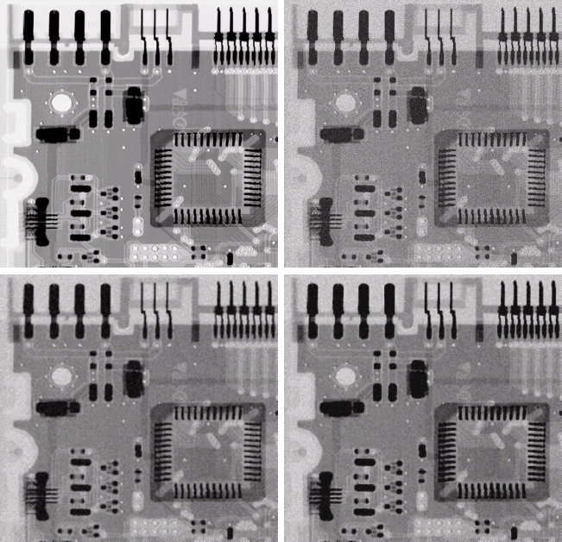
Noise Removal Examples
18
of 46
Image Corrupted By Gaussian Noise
Original Image
After A 3*3 Arithmetic Mean Filter
After A 3*3 Geometric Mean Filter

Slide 20
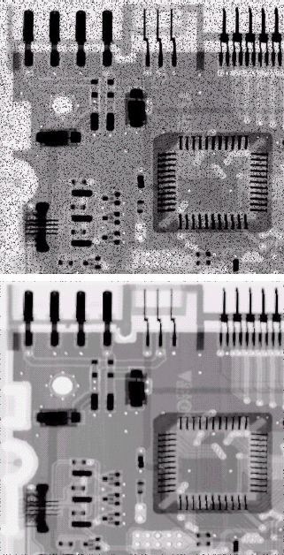
Noise Removal Examples (cont…)
Image Corrupted By Pepper
Noise
Result of Filtering Above
With 3*3
Contraharmonic
Q=1.5

Slide 21
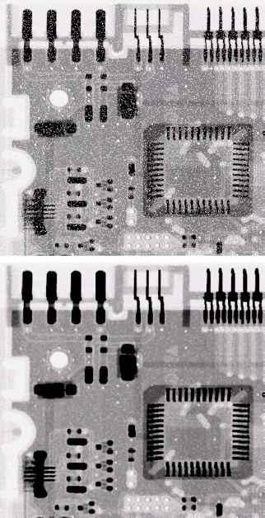
Noise Removal Examples (cont…)
Images taken from Gonzalez & Woods, Digital Image Processing (2002)
Image Corrupted By Salt Noise
Result of Filtering Above With 3*3 Contraharmonic Q=-1.5

Slide 22
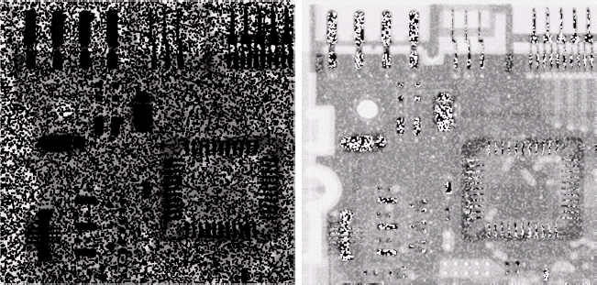
Contraharmonic Filter
Choosing the wrong value for Q when using the contraharmonic filter can have drastic results
Images taken from Gonzalez & Woods, Digital Image Processing (2002)

Slide 23
Order Statistics Filters
Spatial filters that are based on ordering the pixel values that make up the neighbourhood operated on by the filter
Useful spatial filters include
Median filter
Max and min filter
Midpoint filter
Alpha trimmed mean filter
Images taken from Gonzalez & Woods, Digital Image Processing (2002)

Slide 24
Median Filter
Median Filter:
f^{ˆ}(x, y) = median{g(s,t)}
(s,t )∈S_{xy}
Excellent at noise removal, without the smoothing effects that can occur with other smoothing filters
Particularly good when salt and pepper noise is present

Slide 25
Max and Min Filter
Max Filter:
f^{ˆ}(x, y) = max {g(s,t)}
(s,t )∈S_{xy}
Min Filter:
f^{ˆ}(x, y) = min {g(s, t)}
( s,t )∈S_{xy}
Max filter is good for pepper noise and min is good for salt noise

Slide 26
Midpoint Filter
Midpoint Filter:
f^{ˆ}(x, y) = ^{1 ⎡} max {g(s, t)}+ min {g(s, t)}⎤
2 ⎣
⎢( s,t )∈S
⎥
( s,t )∈S
⎦
xy xy
Good for random Gaussian and uniform noise

Slide 27
Alpha-Trimmed Mean Filter
Alpha-Trimmed Mean Filter:
∑ g (s, t)
f^{ˆ}(x, y) = ¹
mn − d
r
( s,t )∈S _{xy}
We can delete the d/2 lowest and d/2 highest grey levels
So g_{r}(s, t) represents the remaining mn – d Pixels
The variable d in the equation for the Alpha-Trimmed Mean Filter represents the number of the lowest and highest grey levels to be deleted.

Slide 28
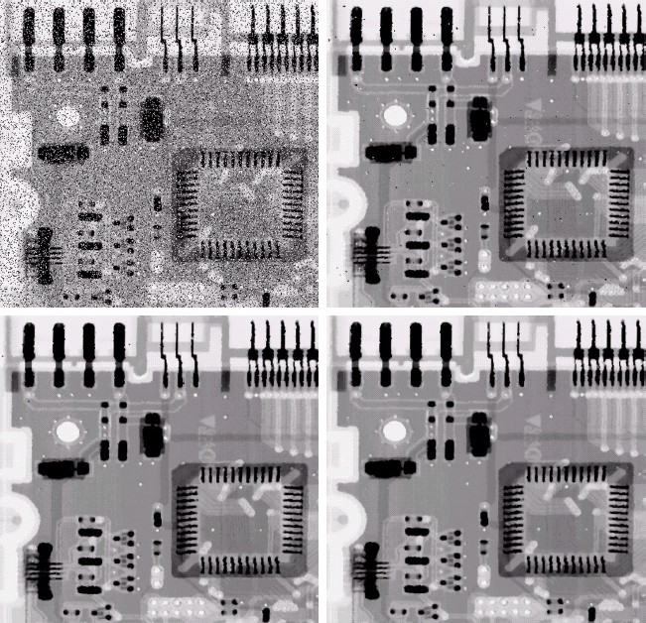
Noise Removal Examples
Image Corrupted By Salt And
Pepper Noise
Result of 1 Pass With A 3*3 Median Filter
Result of 2 Passes With A 3*3 Median
Filter
Result of 3 Passes With A 3*3 Median Filter

Slide 29
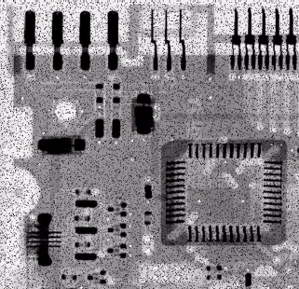
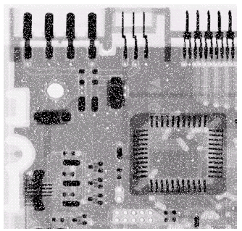
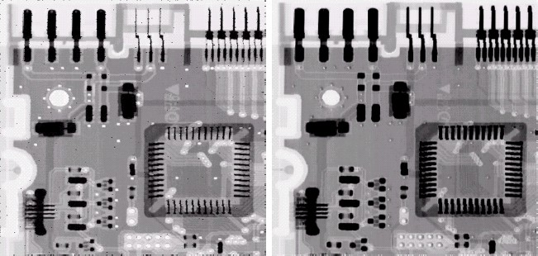
Noise Removal Examples (cont…)
Image Corrupted By Pepper
Noise
Image Corrupted By Salt Noise
Result Of Filtering Above With A 3*3 Max Filter
Result Of Filtering Above With A 3*3 Min Filter

Slide 30
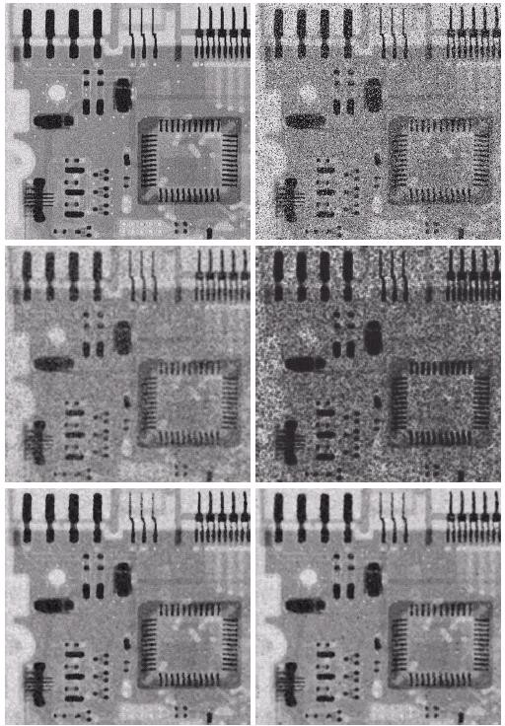
Noise Removal Examples (cont…)
Image Corrupted By Uniform
Noise
Image Further Corrupted
By Salt and Pepper Noise
Images taken from Gonzalez & Woods, Digital Image Processing (2002)
Filtered By 5*5 Arithmetic Mean Filter
Filtered By 5*5 Geometric Mean Filter
Filtered By 5*5 Median
Filter
Filtered By
5*5 Alpha-Trimmed Mean Filter

Slide 31
Adaptive Filters
The filters discussed so far are applied to an entire image without any regard for how image characteristics vary from one point to another
The behaviour of adaptive filters changes depending on the characteristics of the image inside the filter region
We will take a look at the adaptive median filter

Slide 32
Adaptive Median Filtering
The median filter performs relatively well on impulse noise as long as the spatial density of the impulse noise is not large
The adaptive median filter can handle much more spatially dense impulse noise, and also performs some smoothing for non- impulse noise
The key insight in the adaptive median filter is that the filter size changes depending on the characteristics of the image

Slide 33
Adaptive Median Filtering (cont…)
Remember that filtering looks at each original pixel image in turn and generates a new filtered pixel
First examine the following notation:
^{z}min
^{z}max
^{z}med
z_{xy}
^{S}max
= minimum grey level in S_{xy}
= maximum grey level in S_{xy}
= median of grey levels in S_{xy}
= grey level at coordinates (x, y)
=maximum allowed size of S_{xy}

Slide 34
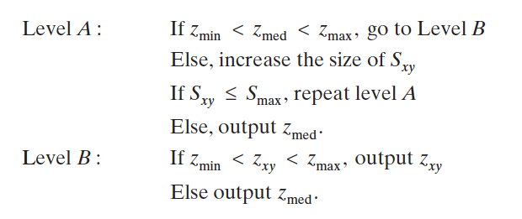
Adaptive Median Filter Algorithm
Set initial window size.
  S_xy = the support of the filter centerd at (x, y)
Compute the minimum, maximum, and median of the pixels in the window.
  z_min = minimum grey level in Sxy
  z_max = maximum grey level in Sxy
  z_med = median of grey levels in Sxy
  z_xy = grey level at coordinates (x, y)
Compare the median to the window's boundaries.
If the median is not an impulse, move to the next step. If it is, increase the window size and repeat the process.
  S_max = maximum allowed size of Sxy
Replace the current pixel with the median value.

Slide 35
Adaptive Median Filtering (cont…)
Level A:
A1 = z_{med} – z_{min} A2 = z_{med} – z_{max}
If A1 > 0 and A2 < 0, Go to level B Else increase the window size
If window size ≤ repeat S_{max} level A Else output z_{med}
B1 = z_{xy} – z_{min} B2 = z_{xy} – z_{max}
If B1 > 0 and B2 < 0, output z_{xy}
Else output z_{med}
Level B:

Slide 36
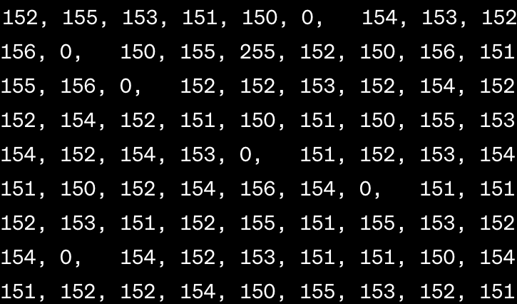
Example
151
152
Z_min = 0, z_med = 151, z_max = 156, z_xy = 0
Z_min = 0, z_med = 153, z_max = 156, z_xy = 150
Z_min = 0, z_med = 152, z_max = 255, z_xy = 255

Slide 37
Adaptive Median Filtering (cont…)
The key to understanding the algorithm is to remember that the adaptive median filter has three purposes:
Remove impulse noise
Provide smoothing of other noise
Reduce distortion

Slide 38
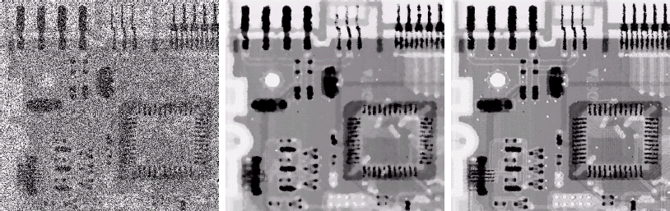
Adaptive Filtering Example
Images taken from Gonzalez & Woods, Digital Image Processing (2002)
Image corrupted by salt and pepper noise with probabilities P_{a} = P_{b}=0.25
Result of filtering with a 7
* 7 median filter
Result of adaptive median filtering with i = 7

Slide 39
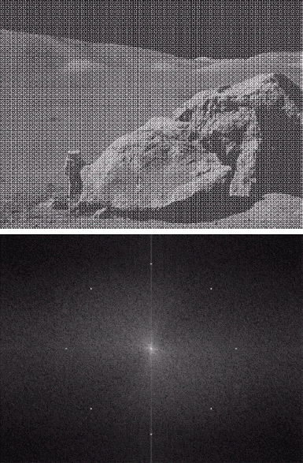
Periodic Noise
Typically arises due to electrical or electromagnetic interference
Gives rise to regular noise patterns in an image
Frequency domain techniques in the Fourier domain are most effective at removing periodic noise
Images taken from Gonzalez & Woods, Digital Image Processing (2002)

Slide 40
Band Reject Filters
Removing periodic noise form an image involves removing a particular range of frequencies from that image
Band reject filters can be used for this purpose An ideal band reject filter is given as follows:
⎧
W
⎪1 if D(u, v) < D₀ − ₂
⎪
H (u, v) = ⎨0 if D₀ − ≤ D(u, v) ≤ D₀ +
⎪ 2
W
W
2
W
⎪₁
if D(u, v) > D +
⎪⎩
0
2

Slide 41
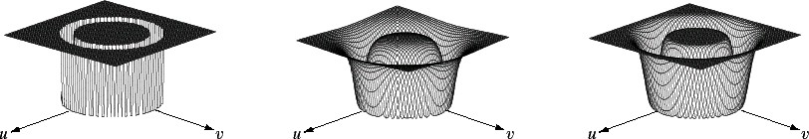
Band Reject Filters (cont…)
The ideal band reject filter is shown below, along with Butterworth and Gaussian versions of the filter
Images taken from Gonzalez & Woods, Digital Image Processing (2002)
Ideal Band Reject Filter
Butterworth Band Reject Filter (of order 1)
Gaussian Band Reject Filter

Slide 42
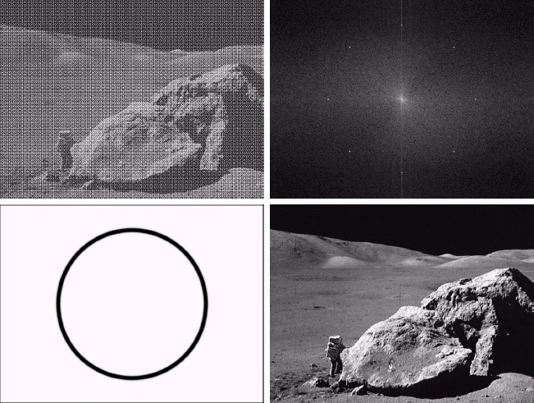
Band Reject Filter Example
Images taken from Gonzalez & Woods, Digital Image Processing (2002)
Image corrupted by sinusoidal noise
Fourier spectrum of corrupted image
Butterworth band reject filter
Filtered image

Slide 43
Summary
In this lecture we will look at image restoration for noise removal.
Restoration is slightly more objective than enhancement.
Spatial domain techniques are particularly useful for removing random noise.
Frequency domain techniques are particularly useful for removing periodic noise.

